Slide 1

SVKM’s Institute of Technology, Dhule department of Information Technology
Final Project Presentation
On
“Smart Guidance Stick”
Virtual Eye
By
20.Shruti Pramod Kothawade
40.Gaurav Dnyaneshwar Pawar
47.Mahek Faruk Sayyad
33.Jay Hemant Patil
Guide
“Prof. Mangesh Balpande”

Slide 2

Content
Group Details
Project Motivation
Problem Statement
Introduction
Approach / Technology Stack

Slide 3
Group Details
Project Title : Smart Guidance Stick – Third Eye
Project Group Members:
T2054491246053, Shruti Kothawade
T2054491246018, Gaurav Pawar
T2154491246027, Mahek Sayyad
T2054491246023, Jay Patil

Slide 4
Motivation
Blind people often face challenges in navigating their surroundings safely and independently.
This project aims to develop a smart guidance stick that is more affordable and user-friendly than the existing products on the market.
Significant Impact :
Avoid obstacles.
Navigate around unfamiliar terrain.
Find their way to familiar destination hassle free.
Emergency Contact.

Slide 5
Problem Statement
"Developing an affordable and user-friendly smart guidance stick for blind individuals to navigate their surroundings independently."

Slide 6
Introduction
Objective : Affordable and user-friendly technology solution.
Approach : To provide real-time obstacle detection
Innovation : Unique sensor technology, GPS and Emergency system set the project apart from existing solutions.
Feasibility : Secure and maintainable solution using existing programming languages and components.
Potential : Meaningful difference in the lives of visually impaired individuals and their families.

Slide 7
Technology Stack
HARDWARE
ESP32CAM
SOFTWARE
Arduino IDE (Integrated Development Environment)
Vibrating Coin Motor
Arduino Nano
Ultrasonic Sensor
GSM 800L
GPS NEO 6M
Libraries for ESP32CAM, GSM 800L, GPS NEO 6M, Ultrasonic Sensor
Arduino programming

Slide 8
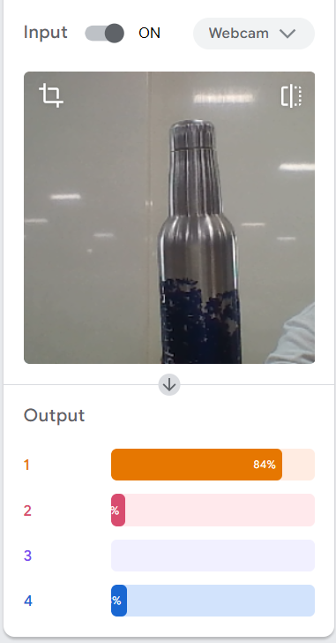
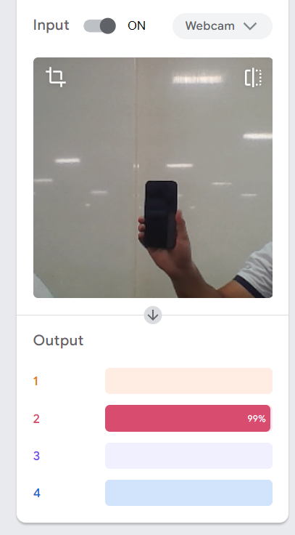
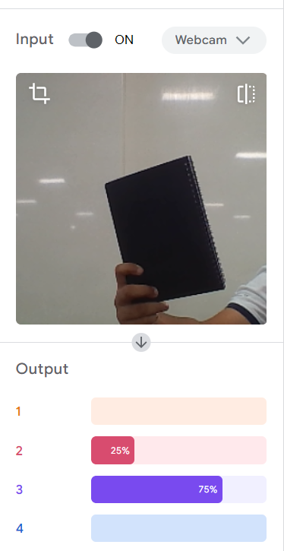
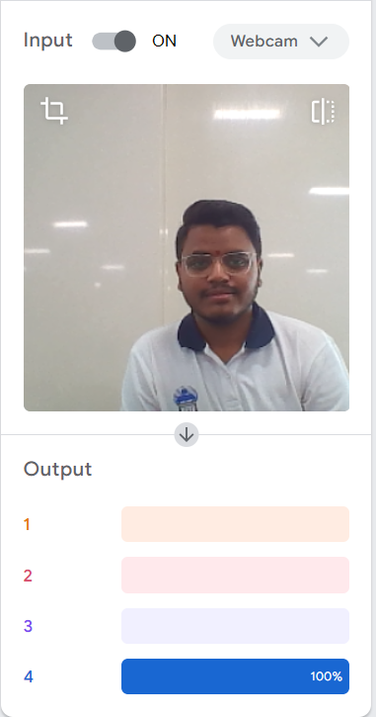
Experiment and accuracy:
Bottle
Phone
Book
Person

Slide 9
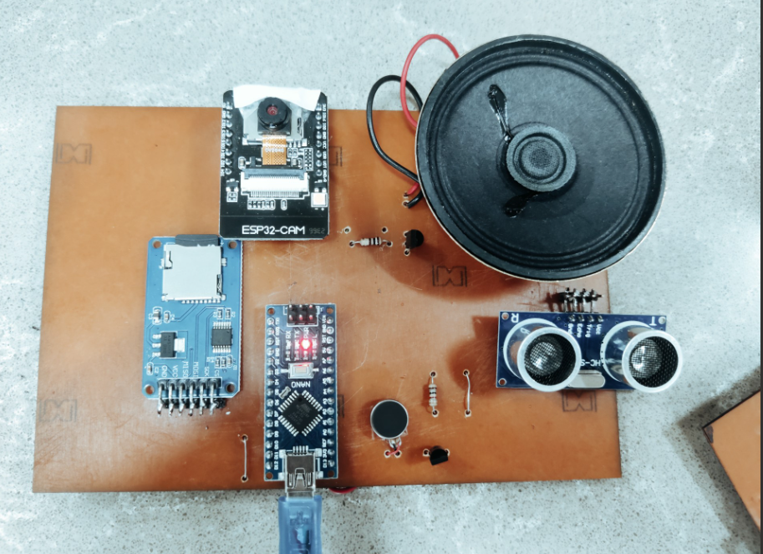
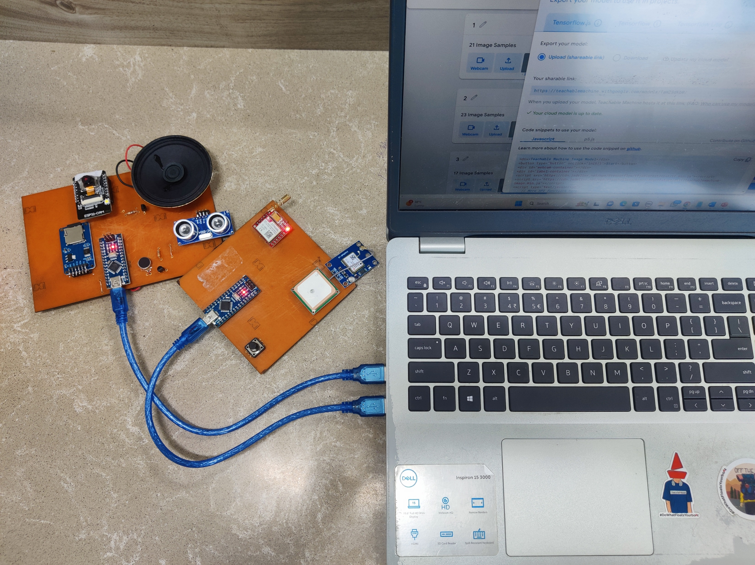
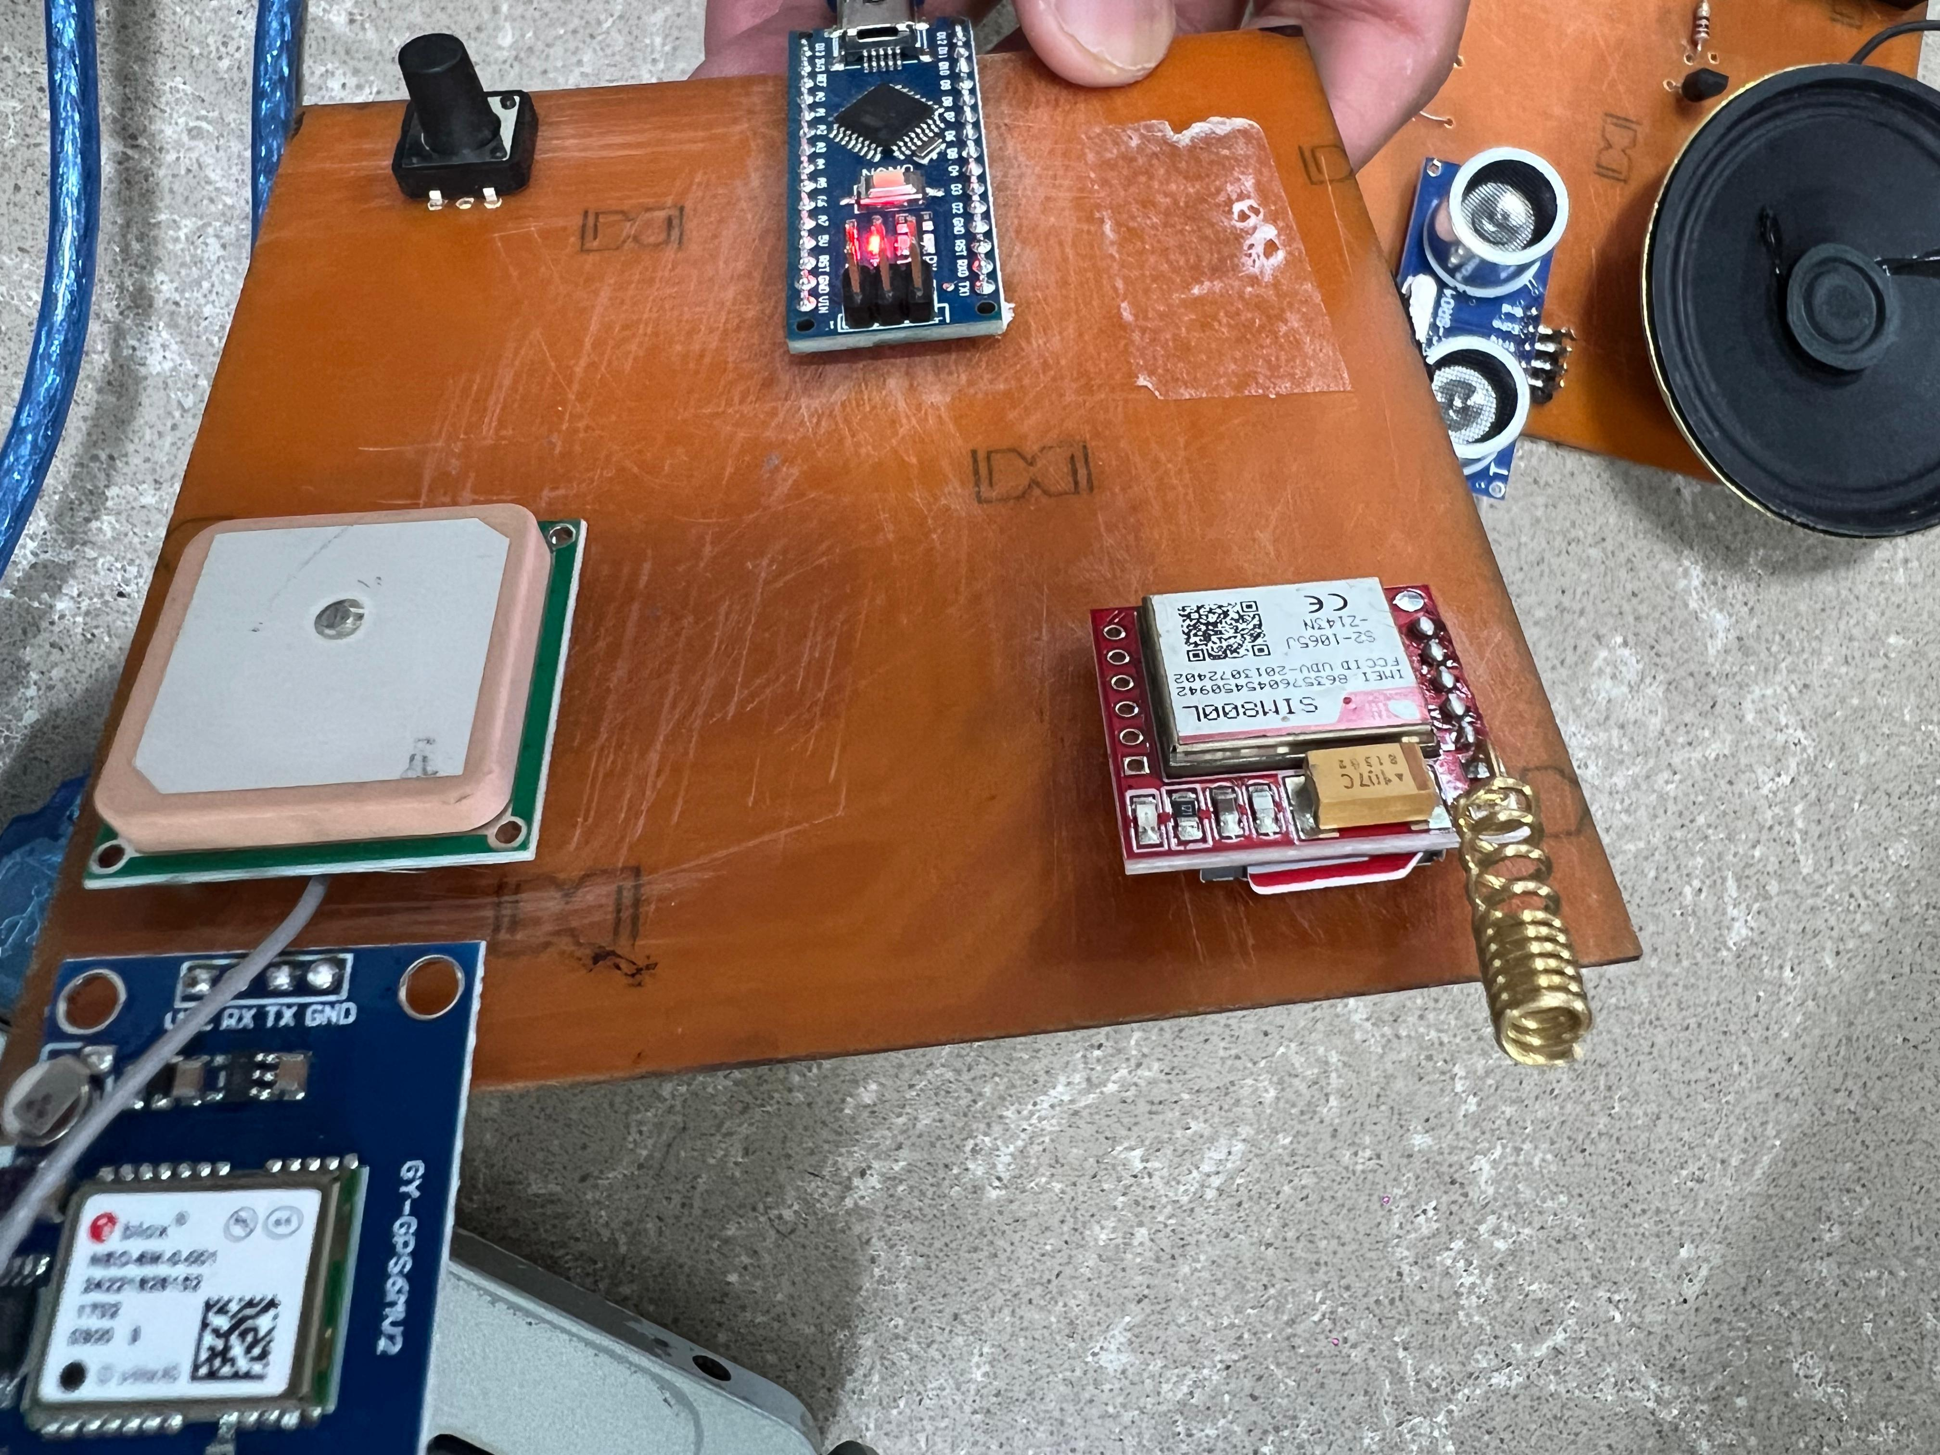
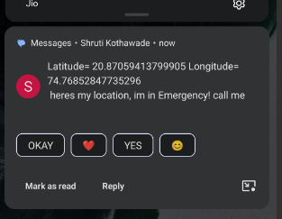
Results:
Detection system
Entire system
Emergency system
Emergency notified to users registered contacts

Slide 10
Thank You

Slide 11
Feature | Existing Systems | Our System
Sensors | Typically use ultrasonic sensors | Uses a variety of sensors, including ultrasonic and laser sensors
Actuators | Typically use vibration motors | Uses a variety of actuators, including vibration motors, speakers, and LED lights
Communication module | Typically does not have a communication module | Has a communication module that allows it to communicate with other devices, such as a smartphone via msg
Software | Typically proprietary and closed-source | Open-source and customizable
Cost | Can be expensive | Relatively inexpensive
User-friendliness | Can be difficult to use, especially for blind users who may not be familiar with technology | More user-friendly and accessible to blind users
Accuracy | Not always accurate, and they can sometimes miss obstacles | More accurate and reliable
Durability | Not always durable and can be easily damaged | More durable and resistant to damage

Slide 12
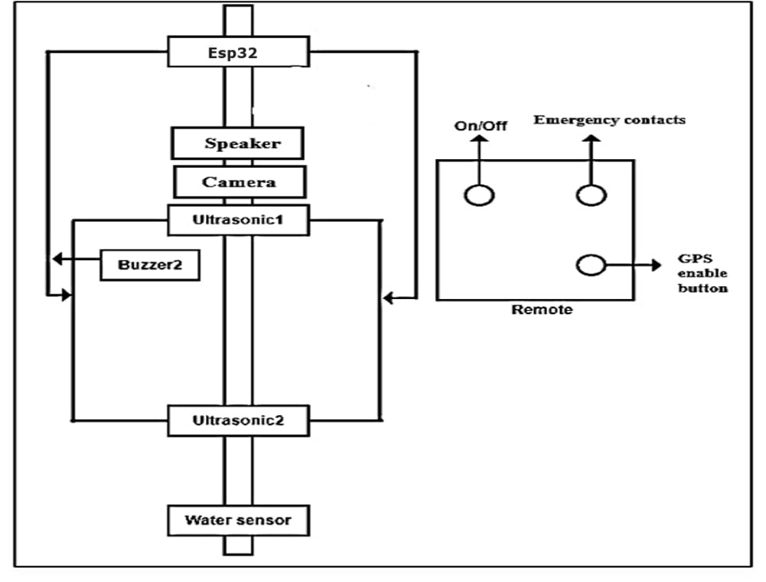




System Design Architecture:

Slide 13
Start
no
Flow Diagram
Is device moving
Get the obstacle data using sensor
within 50 cm
yes
Obstacle’s data processing and matching with database
no
yes
Is obstacle data
match found
Obstacle name is unknown
Spell the obstacle name in voice message
Obstacle null
stop

Slide 14
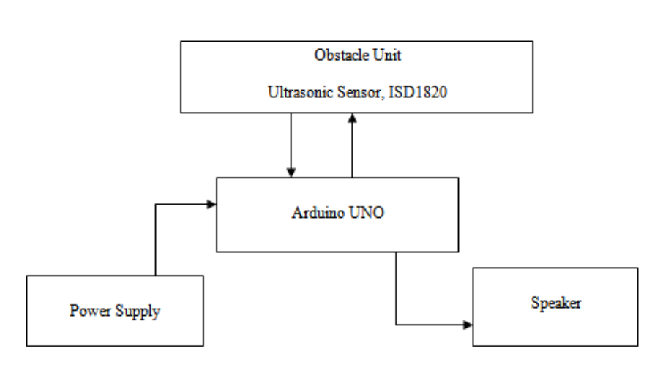
Block diagram

